Slide 1
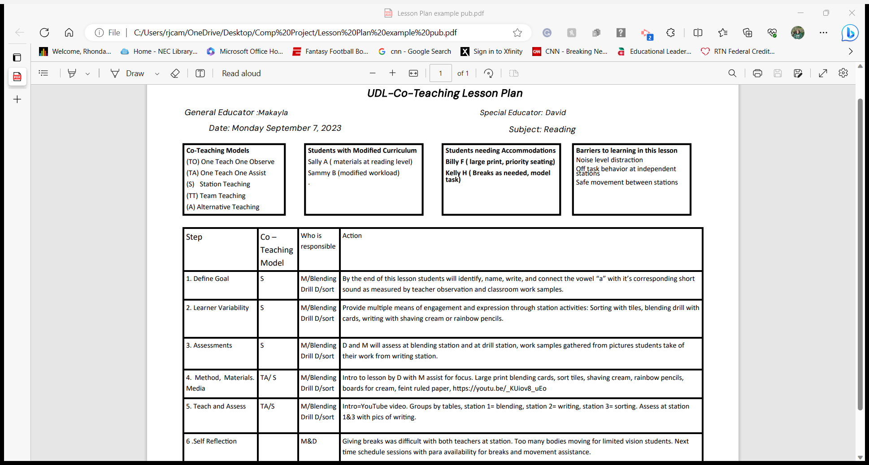

Notes:
Hi Everyone,
I have created a lesson plan format that combines co-teaching strategies with the principles of Universal Design for Learning. This lesson plan is set up to be created with input from both general and special educators, so the roles and responsibilities are clearly set out.
Look at the four boxes on the top of the page. The box on the far left has abbreviations for the 6 different co-teaching models. Remember you can use multiple model of co-teaching during one lesson.
The next box is a section for students with a modified curriculum. It is important to have that reminder in front of you as you develop the lesson.
The next section is for students needing accommodation. In the example I created Billy will need materials with larger print and priority seating. Kelly is going to need breaks and someone to model the task. Universal Design for Learning principles are all about removing barriers to learning. Billy’s accommodations can be met easily by choosing large blending cards which can be used by all students. Although Kelly could benefit from the assistance of a paraprofessional in the room for this lesson to assist with modeling and breaks, I suggest applying the UDL principles of removing barriers and model the activities for all students at the beginning of the lesson using the special educator to assist with model up close for Kelly and schedule small movement breaks in between every other rotation for all students.
The last box at the top gives space and reminders to look for barriers to learning. This lesson has students at different stations so there will be a noise component along with off task behavior at independent stations and the distraction of movement when the stations rotate. I would plan for these barriers and be proactive by practicing appropriate noise levels, and how to move safely between stations to reduce the barriers. I would also keep the station time appropriate to the age level to reduce the off-task behavior. I have incorporated an assessment task in my independent station to help keep students on task.
Moving down to the lesson itself, there are 6 steps to the lesson. The first is defining a learning goal. By clearly defining what a student needs to learn in the lesson, potential barriers to learning can be assessed and flexible options can be provided. In the simple lesson I designed I took into consideration the accommodation needed by Billy and Kelly. I can meet their needs by using larger print cards for all students, providing a scheduled break for all between stations, and keeping the groups small so Billy can be near the teacher as needed.
The next item to consider is learner variability. This is understanding the needs of your students, challenges in the learning environment, and recognizing the scaffolding students might need to participate. In my example, I am providing multiple means of engagement and expression through my stations. Students will practice short ‘a” recognition through an introductory lesson where they will hear the content, practice with manipulatives to touch the content, verbally through a blending drill, and again touch and motorically through writing with colored pencils or shaving cream. Goal achievement can be assessed at any station.
Next is assessment. In my lesson, observational data along with pictorial evidence will be collected.
For the teach and assess section layout exactly what you want to happen. Remember to use many different modalities to address learner variability and provide flexibility. In my lesson, I am using media during the introduction to catch my students' attention, and then moving on to short sessions of activities using manipulatives and movement.
Lastly, remember to self-reflect. This is important to do shortly after the lesson. List the parts of the lesson that worked well for your students and did not work so well. It could be Kelly needed modeling at each station rather than the beginning or Sammy’s modified workload needs adjustments. Writing it down ensures these issues will be considered in the next lesson and you can make provisions for these needs.

