Slide 1
Synergetic Harmonic Eudemonia between Regular Ed and Special Education Teachers
Presented by:
Rhonda J Campbell M.Ed.

Slide 2
Inclusion
IDEA
All teachers responsible for educating students with special needs
Barriers to successful inclusion
Planning is key
Notes:
Now we all know inclusion is here to stay. Inclusion is a legal mandate from the reauthorization of IDEA (Individuals with Disabilities Education Act), which upholds the provision of the least restrictive environment (LRE). Inclusion is the practice of bringing services and support to children with special needs into the general education classroom, as opposed to removing special needs students from learning experiences with their same-age peers. The education of students with special needs is no longer the responsibility of just special education teachers. The inclusion of students with disabilities in the general education setting is now the norm rather than the exception. However, for many teachers (including special education teachers), there are certain barriers that may prevent successful inclusion in a classroom. Having regular ed and special ed teachers work together can be difficult. The biggest barriers to the collaboration between regular ed and special ed teachers are knowledge of position responsibilities, common planning time, and a flexible plan. Most regular ed teachers receive little to no training before they are expected to teach students with disabilities in their classes. To make this work, planning is the key. Both teachers (regular ed and special ed) must make the effort to plan together. There is no denying that working with students with special needs requires a great amount of effort and time. Teaching students with learning disabilities comes with added responsibilities. But when it comes to organizing a classroom to meet the needs of all students, both regular ed and special ed teachers must work together.

Slide 3
Viewing special education and regular education through Bowman and Deals four frames.
Integration of students
with special needs into
general ed classrooms
Bolman and Deal’s Framework
Special Education
General Education
Eudemonia
Notes:
Viewing special education and regular education through Bowman and Deals four frames.
In the realm of education, the integration of special education students into regular education classrooms has become increasingly important. To gain a comprehensive understanding of the challenges and opportunities associated with teaching both special education and regular education students, it is crucial to explore various viewpoints and frameworks. This presentation aims to examine the view of teaching special education and regular education through the lens of Bowman and Deals four frames with an addition of a fifth frame developed by my doctoral cohort called Eudemonia. These five frames offer insightful perspectives on effective inclusive teaching practices.

Slide 4
Human
Resources
Structural
Eudemonia
Political
Symbolic
Notes:
An Overview of Bolman and Deal’s Framework
Bowman and Deal’s four-frame model provides a comprehensive framework for analyzing organizations and leadership. This framework encompasses four perspectives, the structural frame, the human resource frame, the political frame, and the symbolic frame. My doctoral cohort at New England College developed a fifth frame called Eudemonia which can further our understanding when examining the roles of regular ed and special ed play in the life of a student. .The Eudemonia frame serves as a tuning fork for the original four frames. Viewing leadership situations through this frame allows for gauging the alignment of strategic thinking, decision-making, problem-solving, and collaboration, ensuring a greater level of synergy.

Slide 5
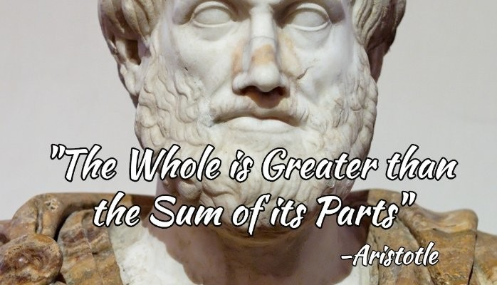
Synergy
Notes:
The old saying that the whole is greater than the sum of its parts expresses the basic meaning of synergy. Synergy means each part feeds off all the others, thus making a whole that is greater than the sum of the individual parts. This can happen in successful brainstorming sessions where each person's idea triggers another, which triggers another until a conclusion is reached that is greater than any one person could have created alone. This can happen when people work together. The net result is greater than the individual contribution of its members. Synergy is creating something in cooperation which in turn provides a multiplier that positively affects the outcome. In his work on collective teacher efficacy, John Hattie emphasizes the importance of teachers working together in professional learning communities. By doing so, teachers have a shared goal: the learning of their students. Teachers must tightly align their actions to student outcomes. This way, teachers can clearly see the connection between what they do and the results that follow. Synergy through the frames allows for always keeping the major goals of teaching, the learning of their students, in focus when decisions are made which is the fifth frame, Eudemonia.

Slide 6
The Structural Frame Focuses on the existing structure of an organization or hierarchy.
General Education
Special Education
Teachers establish clear structures and routines to create a conducive learning environment for all.
The focus is on designing individualized education plans IEPs and implementing strategies to meet the unique needs of students with disabilities.
Notes:
The Structural Frame focuses on the existing structure of an organization or hierarchy. In special education, teachers focus on designing individualized education plans IEPs and implementing strategies to meet the unique needs of students with disabilities, while regular education teachers establish clear structures and routines to create a conducive learning environment for all. Special Ed teachers are most often included in school-wide curriculum training alongside regular ed teachers and, therefore, familiar with the programs being run. Unfortunately, that is not always the case in reverse. Most regular Ed teachers have only been offered one or two classes in special Ed during their teacher prep programs and are very rarely offered professional development regarding their special Ed students. So let's review a few important terms from the special Ed realm that impact both special Ed and regular Ed.

Slide 7
A few important terms from the Special Ed realm that impact both special Ed and General Ed.
A school must provide special education to a child to meet their unique needs.
A school is responsible for teaching students in the least restrictive environment.
$
FAPE
A Free and Appropriate Public Education is not a privilege but a right.
Special Education is a service not a place.
At no cost to the parent.
LRE
Notes:
You might have heard of the acronym FAPE which stands for Free and Appropriate Public Education. This is a right guaranteed by federal law to all students with a disability. This means a school is mandated to provide special education to a child to meet their unique needs, provide related services if needed, such as speech or OT, provide these services at no cost to the parent, and create an Individualized Education Plan (IEP) for the child. In addition, the school is responsible for teaching students in the least restrictive environment. Let’s discuss what some of those terms mean.

Slide 8
IEP is an acronym for Individualized Education Program, which is guided by the Individuals with Disabilities Act (IDEA).
Both General ed and special ed teachers are responsible for the implementation of an IEP.
Notes:
IEP is an acronym for Individualized Education Program, which is guided by the Individuals with Disabilities Education Act (IDEA). An IEP provides special education and related services to a student who is identified as having a disability that negatively impacts their ability to receive academic instruction. A student who receives special education services is entitled to a modification of curriculum, classroom accommodations, specialized instruction, and related services such as occupational therapy, physical therapy, speech therapy and/or counseling. In NH, there are thirteen identifiable disabilities. A Child with a disability " means any person between the ages of 3 and 21, inclusive, who have been identified and evaluated by a school district according to rules adopted by the state board of education and determined to have an intellectual disability, a hearing impairment including deafness, a speech or language impairment, a visual impairment including blindness, an emotional disturbance, an orthopedic impairment, autism, traumatic brain injury, acquired brain injury, another health impairment, a specific learning disability, deaf-blindness, multiple disabilities, or a child at least 3 years of age but less than 10 years of age, experiencing developmental delays, who because of such impairment, needs special education or special education and related services. Both General ed and special ed teachers are responsible for the implementation of an iep.

Slide 9
Inclusive Education
Values Diversity
Appreciates unique contributions
All students feel safe
Trained staff
Notes:
Inclusion: Inclusive education means different and diverse students learning side by side in the same classroom. Inclusive education values diversity and the unique contributions each student brings to the classroom. In a truly inclusive setting, every child feels safe and has a sense of belonging. School staff have the training, support, flexibility, and resources to nurture, encourage, and respond to the needs of all students. Students may require accommodations and modifications to learn effectively alongside their peers.

Slide 10
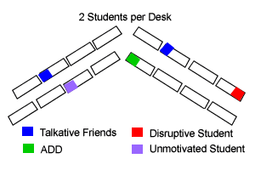
Accommodation
Remove learning barriers
Same expectations
Dyslexia Accommodation
Focus Accommodation
Notes:
Accommodations remove learning barriers so students can learn the same material as their peers allowing them to meet the same expectations. For instance, A student with dyslexia might listen to an audio version of a book. But it’s still the same book that the rest of the class is reading. Likewise, a student who has trouble focusing might get seated next to the teacher but still must do all the General class assignments.

Slide 11
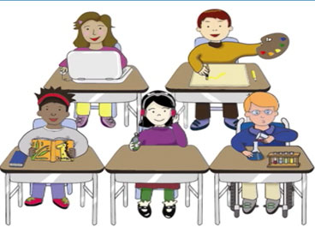
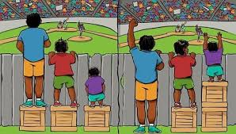
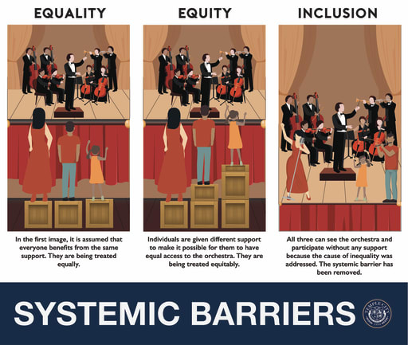
Modification
A change in what is being taught
Different expectations
Leveling the playing field
Focus on equity
Notes:
A modification changes what a student is taught or expected to learn. For example, a student could be assigned shorter or easier reading assignments, or homework that’s different from the rest of the class. Students who receive modifications are not expected to learn the same material as their classmates. Fair does not mean equal. Sometimes students and teachers worry that a student that has extra support in place gives them an unfair advantage, but it's important to remember that all students have individual strengths and needs. Accommodations and modifications are designed to level that playing field. When we focus on equity, we give everyone a chance to thrive in the classroom

Slide 12
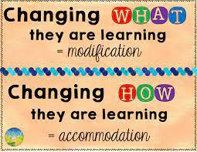
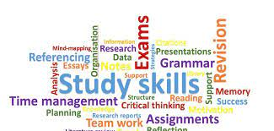
Specially designed Instruction
Tailored curriculum
Accommodation and modifications
Specific skills needed to access curriculum
Qualified Provider
Notes:
Specially Designed Instruction (SDI) is instruction that is tailored to a particular student. It addresses their Individualized Education Program (IEP) goals; accounts for their disability; provides modifications or adaptations to content; and encourages access to the general education curriculum. It teaches specific skills that the student doesn’t yet have but needs in order to access the curriculum. A qualified special education teacher, or provider, like a speech therapist, delivers SDI. That said, SDI can go hand-in-hand with general education strategies and can overlap with general education because it aligns with standards and formative assessments given to general education students. Examples of specially designed programming are be Orton-Gillingham or Wilson sessions or could be Speech and Language services targeting articulation.

Slide 13
The Human Resource Frame focuses on the organization's people.
General Education
Special Education
General education teachers recognize the importance of understanding students’ diverse backgrounds and individual strengths, creating a positive and inclusive classroom culture.
The focus is on building relationships with students, families, and support staff to foster a supportive and inclusive learning community.
Notes:
The Human Resource Frame focuses on the organization's people When viewed through the human resource frame, special education teachers place a strong emphasis on building relationships with students, families, and support staff to foster a supportive and inclusive learning community. In General education, teachers recognize the importance of understanding students’ diverse backgrounds and individual strengths, creating a positive and inclusive classroom culture. Understanding the role of support staff, such as the specialized paraprofessional’s role within the classroom and the chain of command to follow when working with support staff, is an important part of the human resource frame. Under the guidance of a special education teacher, a paraprofessional supports the classroom, and their support often goes to students who have an IEP and need behavioral support, extra help with assignments, tests, or assistance understanding instruction. Paraprofessionals may oversee students with an IEP during tests or offer additional instruction after the teacher completes their lesson, or maybe help a group of students who need reading support complete their assignment. Paraprofessionals work under the guidance of the special ed teacher, where they are given specific strategies and training to work with individual students in the classroom. When General ed and special ed teachers work together, they can use their knowledge of students’ strengths and weaknesses to plan lessons where they effectively utilize support staff to meet the needs of all the students in the classroom.

Slide 14
The Political Frame focuses on where the power lies in an organization and learning how to use it effectively.
General Education
Special Education
General education teachers engage in collaborative decision-making processes involving all stakeholders to address the diverse needs of all students
Special Education teachers are powerful advocates for the rights and needs of students with disabilities ensuring they receive the necessary support and resources.
Notes:
it's important to understand where the power lies in an organization and to learn how to use it effectively. When we look through the political frame, special education, teachers are powerful advocates for the rights and needs of students with disabilities ensuring they receive the necessary support and resources, while General education teachers engage in collaborative decision-making processes involving all stakeholders to address the diverse needs of all students. Special Ed teachers work with the IEP team to develop IEPs to meet the unique needs of students with disabilities that prevent them from accessing the curriculum. Most special ed teachers are responsible for the case management, administration of academic testing, classroom observations, report writing, and data collection for students who qualify for special ed services. They are responsible for attending all meetings, relevant paperwork for those meetings, and progress reports to parents at least once per report card. In addition, they are responsible for the training, scheduling, and effective support. of all paraprofessionals under their supervision. General red teachers are an important part of the IEP team. In the elementary grades, General Ed teachers are with the student all day, through all subject areas, during structured and unstructured times. Their view of the student’s strengths and weaknesses is invaluable to the team. During middle school and high school, teachers usually see students for one or two classes but are still on the front line with the student and able to bring a unique perspective to the table. General Ed teachers are responsible for understanding and managing the general education scope and sequence. They are in tune with how their students perform in a general education context and how their students interact with peers. They control the pace of the class and manage the social dynamics daily. It is important for General education teachers to know that their input is critical to the IEP both for present levels and goal development. The power to meet the needs of all students in the classroom lies in the hands of both the General red teacher and special Ed teacher when they work together as a team. Not all students who struggle have an IEP, and not all students are at the same place in their learning. When General Ed teachers and special Ed teachers work together, They can use their training and knowledge to meet the needs of all students in the classroom.

Slide 15
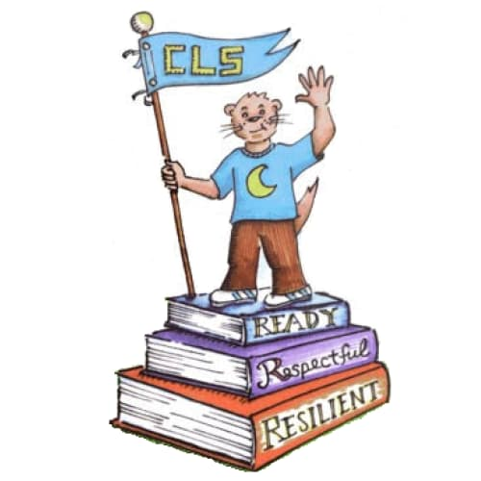
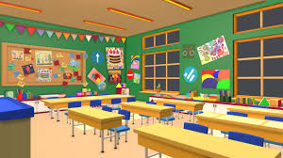
The Symbolic Frame Focuses on vision and inspiration.
General Education
Special Education
General education teachers use symbols and rituals to foster a sense of belonging and identity, recognizing the diversity and strengths of each student.
Special Education teachers focus on creating a classroom environment that values and celebrates the unique contributions and abilities of all students.
Notes:
The Symbolic Frame focuses on vision and inspiration. Educating students who require special education services lies with both the special education staff and the General education staff, as symbols play an important part in the learning of all students. Viewing teaching through the symbolic frame, special education teachers focus on creating a classroom environment that values and celebrates the unique contributions and abilities of all students. General education teachers use symbols and rituals to foster a sense of belonging and identity, recognizing the diversity and strengths of each student. Examples of symbols in the classroom can vary from the arrangement of desks or tables to a classroom mascot. School-wide symbols are aligned with the mission and vision of the school, allowing students and teachers to pair the symbol with slogans and positive affirmations. All students need to have a sense of belonging both in the classroom and school-wide.

Slide 16
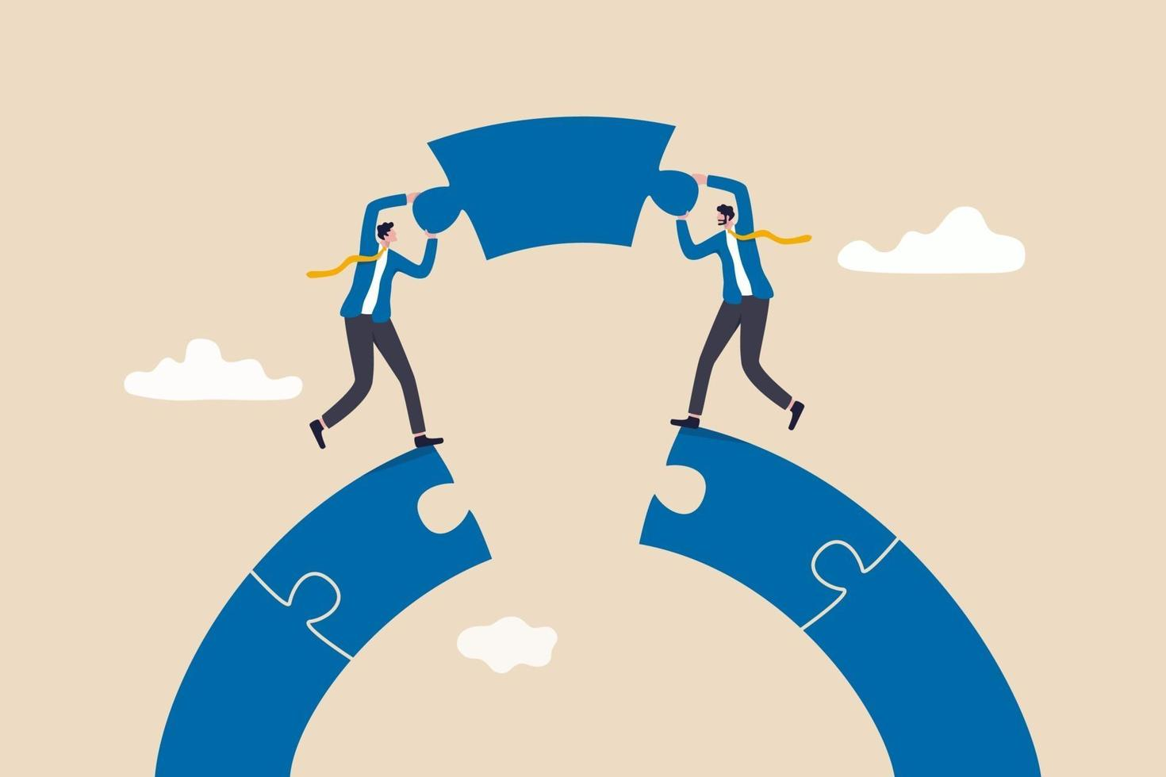
The Eudemonia Frame overlays the other frames bringing them into focus and alignment.
General Education
Special Education
Notes:
The eudemonia frame overlays the Structural, Human Resource, Political, and Symbolic frame, bringing them all together and pointing us toward a common goal of equipping students with the tools they need to live fulfilling and successful lives by creating an environment, both physical and emotional, where everyone is treated with respect and kindness and invited to participate to the best of their ability. This is synergy. Remember, synergy means each part feeds off all the others, thus making a whole that is greater than the sum of the individual parts. The net result is greater than the individual contribution of its members.

Slide 17
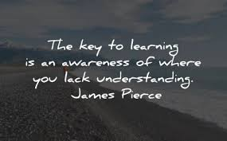
Benefits of the Frames
Understanding the complexity
Highlighting the diversity of students
Create an inclusive and supportive learning environment.
Collective Effort
Notes:
: The benefits of applying the Bowman and Deal framework to General ed and special ed allows an understanding of the complexity of the pairing and acknowledges the multifaceted nature of teaching special education and General education while highlighting the diverse needs of students and the importance of addressing them. By considering the five frames, educators can adopt a comprehensive approach that addresses structural, human, political, and symbolic aspects, creating an inclusive and supportive learning environment. The framework encourages collaboration among educators, families, and stakeholders, fostering collective effort to meet the needs of all students. It also highlights the significance of advocacy for students with disabilities, ensuring they receive appropriate resources and support. Teaching special education and General education students together requires a nuanced understanding of a student’s unique needs and effective instructional strategies. Using Bowman and Deal’s four-frame model offers valuable insights into the structural human political, and symbolic aspects of inclusive education. By applying this framework, educators can create a supportive environment that addresses the diverse needs of all the students fostering their academic and personal growth moreover, through collaboration and advocacy, educators can work toward creating inclusive educational systems that promote equal opportunities for students with disabilities.

Slide 18
How does this all work together?
Whom you work with
How you do the work
Capitalize on individual strengths
Opens up room for conversations about Team teaching and Understanding by Design.
Notes:
You might be asking how this all works together within the classroom setting. The answer is whom you work with and how you do the work. Collaboration allows for multiple points of view to aid in working through classroom challenges. The individual strengths and skill sets teachers bring to the table can be used to meet the needs of all students in the classroom. When implementing the required support for students with an IEP, it is critical for General ed teachers to partner with Special Ed staff and related service providers to understand the underlining purpose of a student’s accommodations and modifications. By using collaboration, methods such as team teaching, and principles of Understanding by Design, teachers can weave in specially designed instruction and supports that will help students make progress. In addition, by applying UDL principles to their lessons, teachers can meet the needs of their whole classroom by proactively anticipating barriers to learning. Supports that help all students access the material can be built in during the planning stage. Teams can make these supports available to all students when it is recognized that students who have IEPs and 504 plans aren't the only ones who have challenges.

